Slide 1
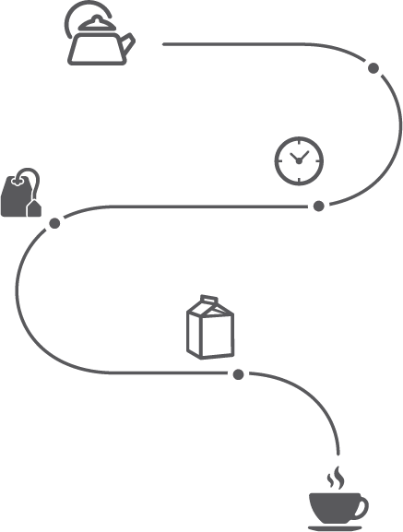
Algorithms - Leveraging Data for Exponential Growth
Algorithms are a set of instructions that are designed to do a specific task. For example, making a cup of tea. The process is documentable, repeatable, shareable, and potentially, scalable.
Yet as simple as that might sound, algorithms are the building blocks for process improvement, software and automation, “Artificial intelligence” (machine learning and deep learning) and much more.
Algorithms help companies make sense of massive amounts of data. In a world with billions of sensors and Internet of Things (IoT) devices, and mind-boggling amounts of data generated every day, algorithms are critical to business success for any exponential organization.
These capabilities are now accessible to startups and mid-market organizations!
A few examples of algorithms at work:
Personalized health: Targeted cancer treatments using DNA sequencing. Early detection of heart conditions using ‘wearables’ (Apple Watch)
Search: “Alexa, find me an electric tea kettle under $50.” (and of course, Google!)
Matching functions: Matching a rider and driver (Uber), a guest to a host (AirBnb), or a shopper to the perfect blouse (Stitch-Fix)
Prediction: Stock performance, autonomous vehicles, Facebook news feeds, consumer behavior
Optimization: Vehicle routing (UPS saves their drivers 85 million miles per year with this gem!)
START
Where to begin in your organization
Identify the problem or need you are trying to resolve
Identify the ‘customer’ with the problem (internal or external to the organization)
Identify the data you have
Identify the data you need
Set up and run experiments to learn about the problem, data and potential solutions
Recruit the right resources to support your decisions and actions.
Boil water
Add tea bag
Remove
tea bag
Steep (3min)
Add milk
Sip a’cuppa
STOP
Tips
Struggling to accurately predict and decide? e.g. Inventory levels, job costing, which styles to order. If you could rapidly predict with near-100% accuracy, what would that do for you?
Where could you automate a costly, repetitive task?
Where might an algorithm (or AI) be used to enhance performance of a person?
Do a cost-benefit analysis for implementing any algorithm. Will the results be worth the cost of developing the algorithm and “feeding” it with data?
Read about Experimentation and download our Experimentation Tool here - https://blog.growthinstitute.com/exo/experimentation
Consider staff-on-demand - resources that you don’t ‘own’ - to quickly access expertise for your experiments.
Work licensed under Creative Commons Attribution-NoDerivatives 4.0 International License. By Growth Institute Inc. For a copy of this license, http://creativecommons.org/licenses/by-nd/4.0/ Rev 1.2 2019-01-06 TO LEARN HOW TO USE THIS TOOL, VISIT www.growthinstitute.com/exo
Notes:
Gazelles Growth Institute - ExO Tools Algorithms form
Form created/curated for Gazelles Growth Institute (growthinstitute.com) by Ann and Gary Ralston (ralstonconsulting.com)
Thanks to our contributors:
Alex Faust
Andrea Argomedo-Halliday
Ann Ralston
Emilie Sydney-Smith
Gary Ralston
Jabeen Quadir
Josh Zollweg
Kent Langley
Michał Monit
Péter Kristóf
License:
Work licensed under Creative Commons Attribution-NoDerivatives 4.0 International License. By Growth Institute Inc. For a copy of this license, http://creativecommons.org/licenses/by-nd/4.0/ Rev 1.0 2018-05-23
Repositories:
GITHUB - https://github.com/exofoundation/ExO-Tool-Kit/releases
GGI Internal Archives
https://info.growthinstitute.com/algorithms
NEW ExOLever

Slide 2

Algorithms - Where to begin
1. Problem
2. Data
3. Solution
What problem or challenge do you wish to solve? Who is the ‘customer’ for the solution?
Do you have the data you need? If not, what data do you need? Where can it be found or captured? (Some data can be purchased, other data is publicly available.)
What experiments could you run to to learn about the problem, data and potential
solutions?
Use our ExO Experimentation Tool to design and run your experiments!
blog.growthinstitute.com/exo/experimentation
If you didn’t have that problem, what would it mean to your organization? (what’s the value of not having the problem?)
Who does this data and subsequent decisions affect? (Consider regulators e.g. GDPR in EU)
How long have you been working on this problem? What have you tried?
See Chapter 4 - Inside the Exponential Organization in Exponential Organizations by Salim Ismail, Michael S. Malone & Yuri van Geest. The Exponential Organizations Master Business Course is a part of the Growth Institute MBD Program. To learn more, visit www.growthinstitute.com/exo Share this tool! blog.growthinstitute.com/exo/algorithms
Work licensed under Creative Commons Attribution-NoDerivatives 4.0 International License. By Growth Institute Inc. For a copy of this license, http://creativecommons.org/licenses/by-nd/4.0/ Rev 1.2 2019-01-06 TO LEARN HOW TO USE THIS TOOL, VISIT www.growthinstitute.com/exo
Notes:
https://info.growthinstitute.com/experimentation-tool
https://info.growthinstitute.com/algorithms-tool

